Slide 1

Zomato – Technical Presentation
Date: 05/30/2020
Presenter: Mohit Bansal

Slide 2
Zomato wants to lay down an approach to increase market share in food delivering app.
!
Problem
Understand Customer Strategy
Which city has maximum and minimum number of restaurants.
How cuisines play role into the ratings of these products.
“Cost of two”, ”Votes”, ”Pictures” analysis.
Relation between pictures and votes.
Top 5 cuisines through out India.
Correlation between different variables.

Slide 3
Problem Statement and Solution Approach
Zomato is one of the largest food aggregators in the world. Inspite of tremendous growth in Indian market, company is in financial loss of $294m and to overcome its losses of the food delivery business in India, Zomato wants to increase its delivery business in India specially be first-in-the-market cities.
STATISTICAL APPROACH #1
Descriptive Analysis
STATISTICAL APPROACH #2
Inferential Analysis

Slide 4
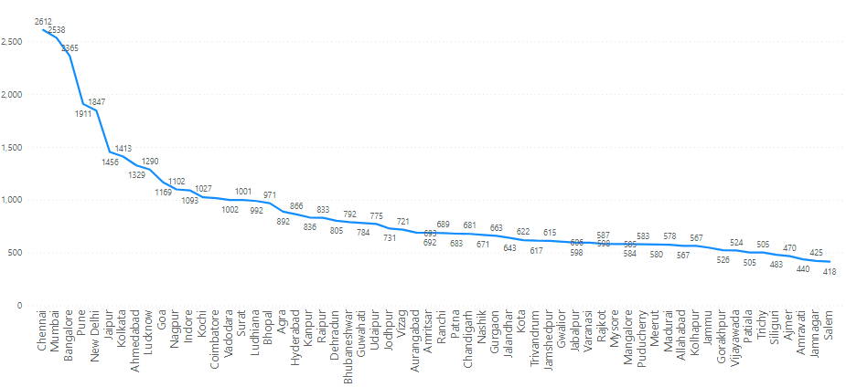
Chennai has most number of restaurants (2612) and Salem has minimum number (418) of restaurants (minimum 400 restaurants in a city)

Slide 5
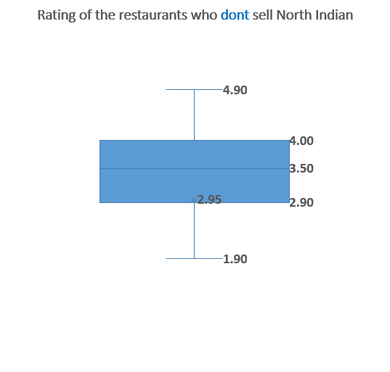
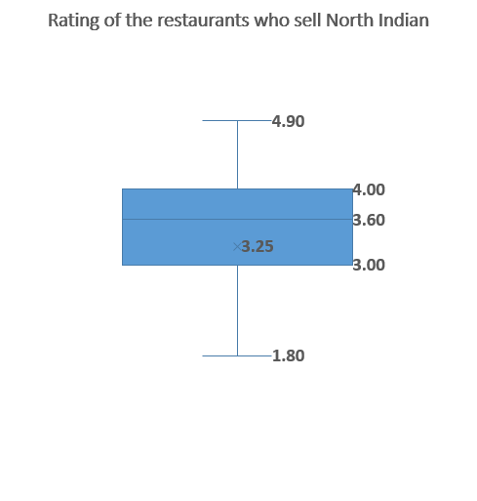
Restaurants who serve North Indian Cuisines have higher avg Rating of 3.25 in comparison to other restaurants having avg rating as 2.95.
Median value is also higher (3.6) who serve North Indian Cuisines than others (3.5)

Slide 6
70% of the restaurants costs less than Rs 500 for two persons.
18% costs between Rs 500 to Rs 1000 for two.
12% costs more than Rs 1000
8% of the all restaurants have “NO votes”. 53% have votes between 1 to 100. 16% have ratings between 100 to 250. 17% have ratings between 250 to 1000.
6% have ratings more than 1000.
16% of the all restaurants have “NO Pictures Uploaded”. 51% have upto 50 pictures. 10% have pictures between 50 to 100. 16% have pictures between 100 to 500. 8% have pictures more than 500.

Slide 7
Scatter Plot: Restaurants with more votes have more pictures uploaded and vice versa.

Slide 8
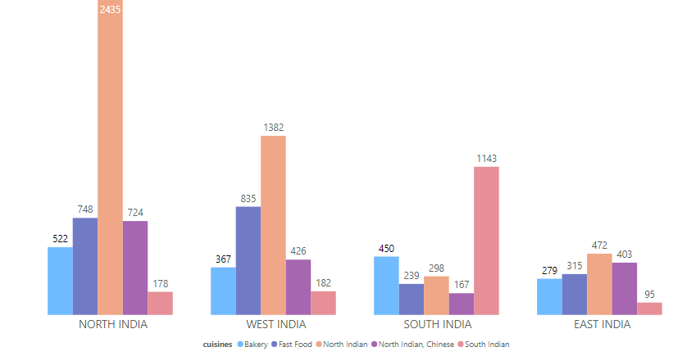
North Indian Cuisine is most likable food followed by Fast food, North Indian + Chinese, Bakery and South Indian respectively.

Slide 9
Correlation Heat map: Only Votes and Pictures Uploaded have a strong positive relationship. Rest other variables don’t have very strong relationship
 | cost_for_two | rating | votes | pictures_uploaded
cost_for_two | 1.00 | 0.27 | 0.25 | 0.32
rating | 0.27 | 1.00 | 0.29 | 0.27
votes | 0.25 | 0.29 | 1.00 | 0.83
pictures_uploaded | 0.32 | 0.27 | 0.83 | 1.00

Slide 10
Summary
Customer Strategy:
Chennai, Mumbai, Banglore, Pune and New Delhi are top 5 cities in terms of number of restaurants.
Restaurants with North Indian Cuisines have higher avg Rating of 3.25 in comparison to other restaurants having avg rating as 2.95.
“Cost for two” 70% of the restaurants costs less than Rs 500 for two persons. 18% costs between Rs 500 to Rs 1000 for two. 12% costs more than Rs 1000
8% of the all restaurants have “NO votes”. 53% have votes between 1 to 100. 16% have ratings between 100 to 250. 17% have ratings between 250 to 1000. 6% have ratings more than 1000.
16% of the all restaurants have “NO Pictures Uploaded”. 51% have upto 50 pictures. 10% have pictures between 50 to 100. 16% have pictures between 100 to 500. 8% have pictures more than 500.
Restaurants with more votes have more pictures uploaded and vice versa. R square value is 50% that means 50% of the movement pictures can be described by votes and vice versa.

